Slide 1
DS PROJECT
Analysing health trends and students’ participation in sports
ME21B1041
ME21B1005

Slide 2
Problem Statement
The objective of this data science project is to analyze current trends in inter-departmental sports at IIITDM Kancheepuram. Specifically, we aim to understand student participation in various sports based on their branch, gender, and identify the challenges they face in sports, including issues related to nutrition, hectic schedules, and the availability of proper equipment. Additionally, we seek to determine the average number of hours students spend training in sports each day per week.

Slide 3
Data Collection
To address the problem statement, we have collected data from various sources using the following methods:
Google Forms: We designed and distributed Google Forms surveys to gather information from the student body. The surveys included questions about the following:
Branch: Students were asked to specify their academic branch (e.g., computer science, mechanical engineering, etc.).
Gender: We collected data on the gender of each student.

Slide 4
Data Collection
Sports Preferences: Students were asked to indicate their sports preferences, which could include multiple options.
Training Hours: Students were asked to estimate the number of hours they dedicate to sports training each day and week.
Challenges: We inquired about challenges students face in pursuing sports, including nutrition, hectic schedules, and the availability of equipment.
Surveys: In addition to Google Forms, we conducted targeted surveys to gather more detailed information from a subset of the student population. These surveys allowed us to dive deeper into specific issues and challenges students face regarding sports participation.

Slide 5
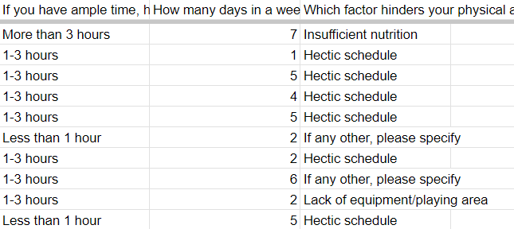
Data Collection
We collected information
from students asking
the amount of time they
are willing to put in their
training, the challenges
they are facing etc.

Slide 6
Past Trends
We leveraged historical data and trends related to inter-departmental sports at IIITDM Kancheepuram. This data included past participation records, event outcomes, and feedback from previous years.
By combining data from Google Forms, surveys, and historical trends, we have created a comprehensive dataset that will enable us to analyze current trends in inter-departmental sports, identify patterns based on branch and gender, and address the challenges and training habits of the students. This data will form the foundation for our data analysis and insights generation.

Slide 7
Data Cleaning
Once we collected the data from various sources, our next step was to clean and preprocess it to ensure that it is ready for analysis. The data cleaning process involved the following steps:
Handling Missing Values: We began by identifying and handling missing values in the dataset. This included looking for and addressing any NULL or NA values in the data. In cases where we couldn't obtain specific responses from survey participants, we used techniques such as imputation to fill in missing values with reasonable estimates. This step was crucial in ensuring that the dataset is complete and reliable.

Slide 8
Data Cleaning
Dealing with Duplicates: To ensure data integrity, we conducted a thorough check for duplicate entries. Duplicate responses were removed to prevent double-counting and to maintain data accuracy.
Data Validation: We validated the data to ensure that it met specific criteria and quality standards. This step helped us identify potential errors or inconsistencies in the dataset. For instance, we checked for outliers or unrealistic values in the "training hours" field to eliminate any anomalies.
Data Encoding: Categorical variables, such as branch and gender, were encoded to numerical values to make them suitable for data analysis and modeling. This included techniques like one-hot encoding or label encoding depending on the nature of the variable.

Slide 9
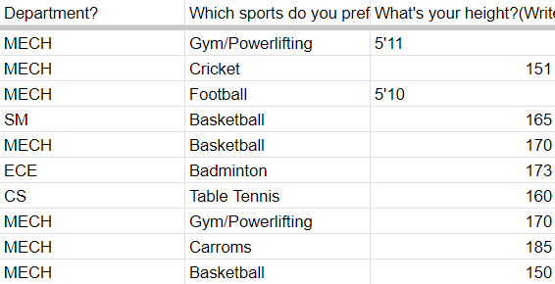
Data Cleaning
Here we can see, that in
the survey that was taken by
us, some students mentioned
their height in feet and inches
instead of cm. We had to
“clean” such data.

Slide 10
Data Collection
Data Integration: We merged data from different sources into a single dataset, aligning it based on common identifiers. This allowed us to combine the information collected through Google Forms, surveys, and historical trends into one cohesive dataset for analysis.
Data Quality Assurance: Finally, we conducted quality assurance checks to ensure that the cleaned data met our project's quality standards. We looked for potential issues or inconsistencies that might affect the reliability of our analysis.

Slide 11
Data Collection
By conducting thorough data cleaning, we have prepared the dataset for further analysis and insights extraction. The cleaned and structured data will now serve as the foundation for our data science techniques, including data visualization and statistical analysis. This process is critical to ensure that the results and insights derived from the data are accurate and reliable

Slide 12
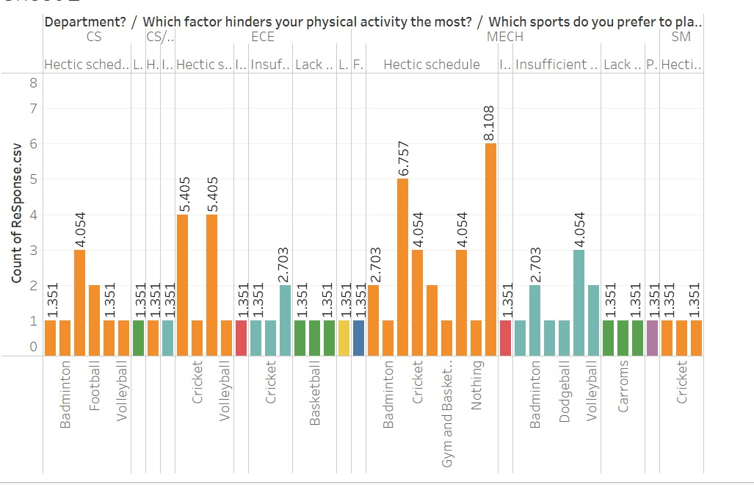
Data Visualization
Here is a graph chart
representing the options
students chose for the question
“Which factor hinders your
physical activity the most?”.
We sorted it according to sports
And branch.

Slide 13
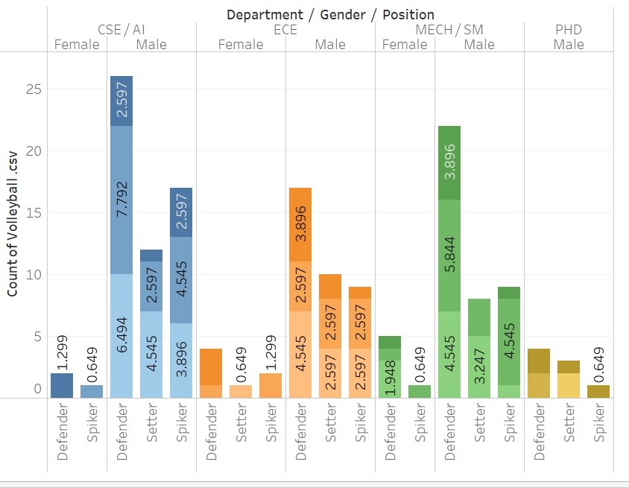
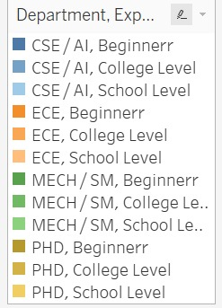
Data Visualization
This is a graph charts
representing the students
that chose volleyball
for the inter department
sports meet. We sorted it
according to their branch,
gender, position and
experience.

Slide 14
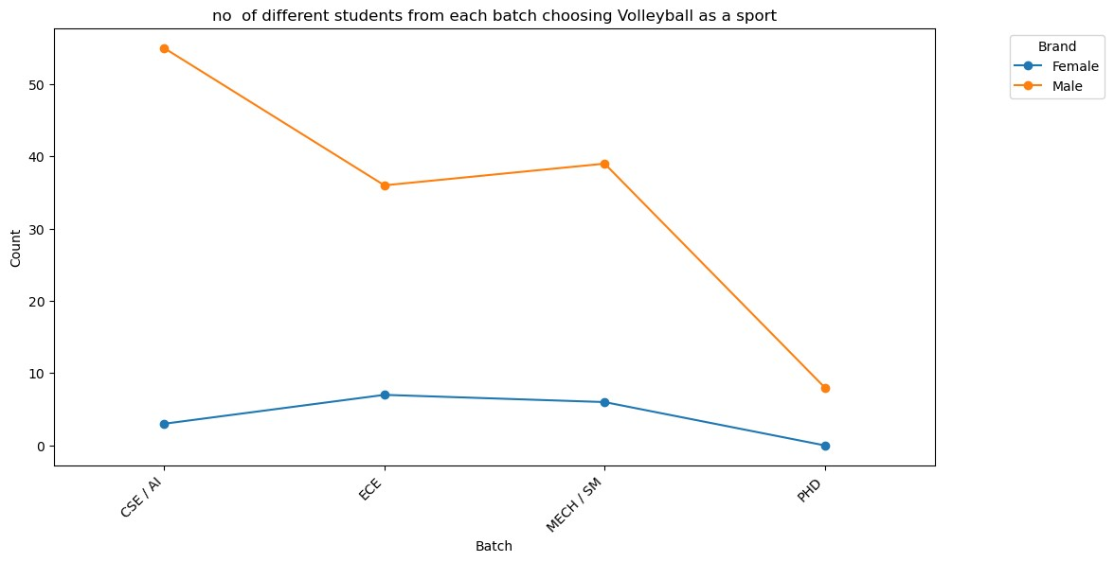
Data Analysis

Slide 15
Data Analysis
In the previous slide, we looked at the number of people choosing volleyball as the sport they preferred the most to play. From the graph we can arrive at the conclusion that participation is least from the PhD students when taking both the genders into account. Less than 10 students preferred volleyball as a sport in PhD.
We can see for Men’s volleyball, the participation is highest from the CSE department, followed by Mechanical and then ECE. For Women’s volleyball, ECE shows a slightly better participation than Mechanical, with CSE showing 3rd best numbers.

Slide 16
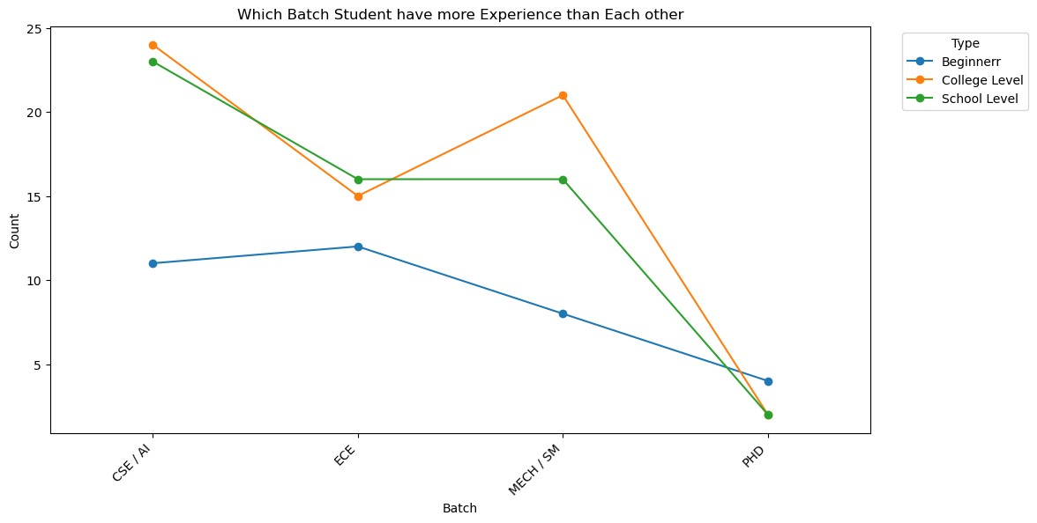

Slide 17
Data Analysis
In the previous slide, we took at a look at the experience of the students who took volleyball as a sport.
ECE has the most beginner level players, with CSE, Mechanical, and PhD coming in 2nd, 3rd and 4th respectively.
CSE has the most school level players with Mechanical and ECE having almost the same amount of players and PhD coming in 3rd.
CSE has the most college level players with Mechanical, ECE and PhD coming in 2nd, 3rd and 4th respectively.
From this graph, we can see that CSE has the most number of experienced players and has a good chance of winning the tournament.

Slide 18
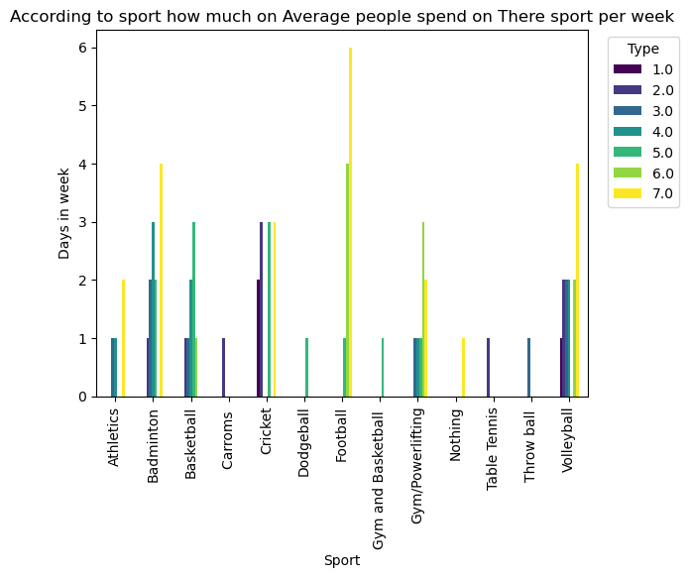
Data Analysis
In this graph, we can see that
the amount of time the players
are willing to invest in the
training for their respective
sports. We can see, that
the students who chose
football as their sport are
the most willing to invest
time in their sport.

Slide 19
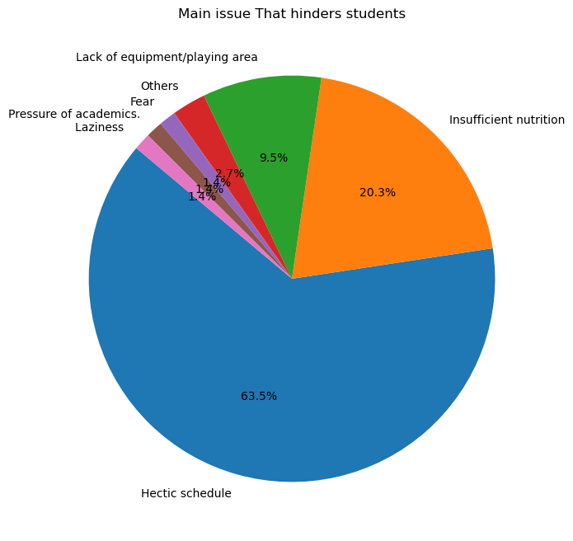
Data Analysis
This is a graph of the factor that
hinders students from playing the
sports they want to play. 63.5% of
the students can’t do so because of
their hectic schedule. 20.3% of the
students say insufficient nutrition
is the reason, while 9.5 don’t play
due to lack of equipment/playing area.

Slide 20
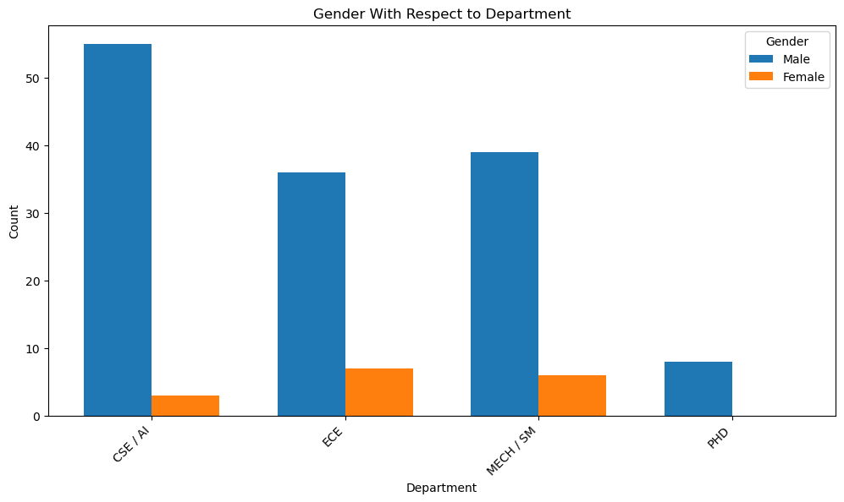

Slide 21
Data Analysis
In the previous slide, we took a look at the comparison between male students and female students who play any sport or do any physical activity regularly.
In every department, Female students show less participation than male students, with CSE having a huge difference in the participation of male students.
We can see that there was no participation from the female PhD students. While men did show some participation, it is less as compared to the other departments.

Slide 22
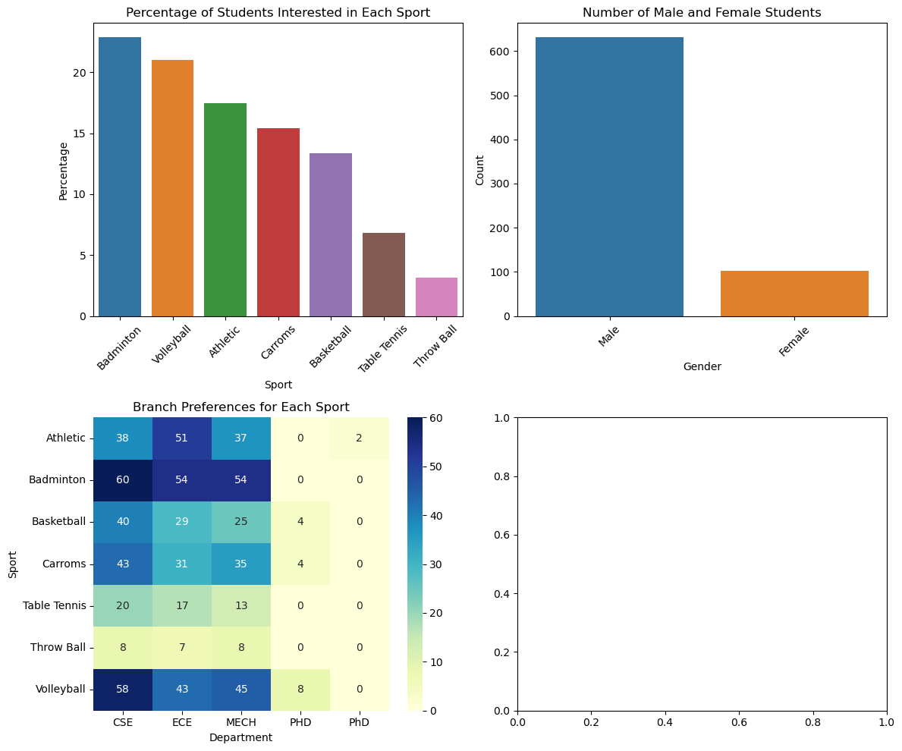

Data Analysis
In the top right corner,
we have a graph that
shows the percentage of
the students that are
interested particular sports.
We can see that most of
the students are interested in
In badminton, while least
number of students are
interested in throwball.

Slide 23
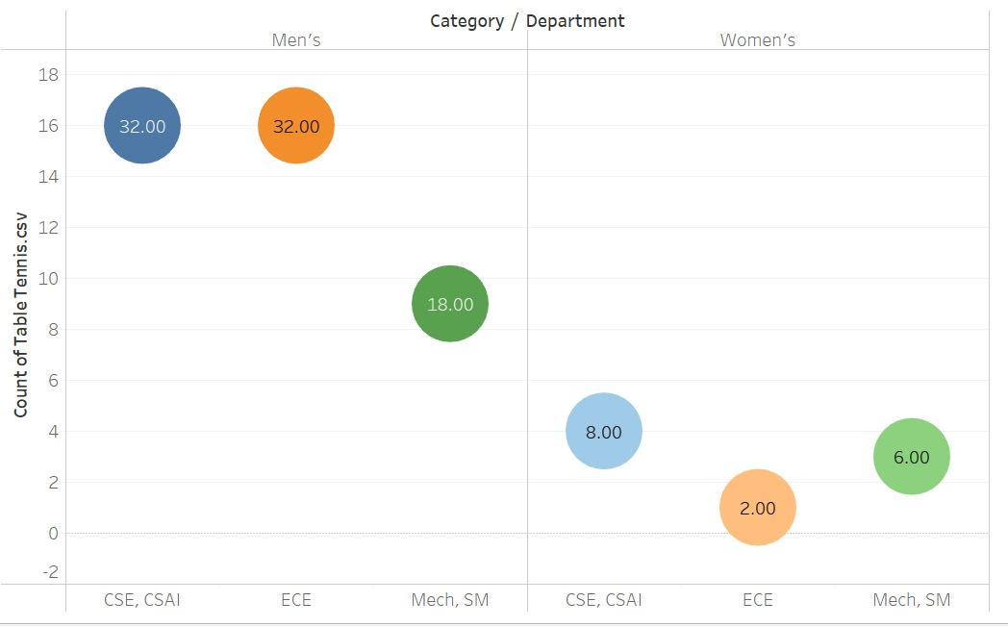
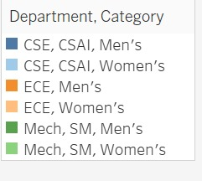
Data Analysis

Slide 24
Data Analysis
In the previous slide, we took a look at the number of students who turned up for the trials for Inter Department Table Tennis tournament.
We can see that, the most participation is shown from ECE students in the male category, with CSE coming in a close second and Mechanical third.
In the women’s category participation is low from all the departments as compared to the male category. CSE shows the most participation with Mechanical slightly behind and ECE third.

Slide 25
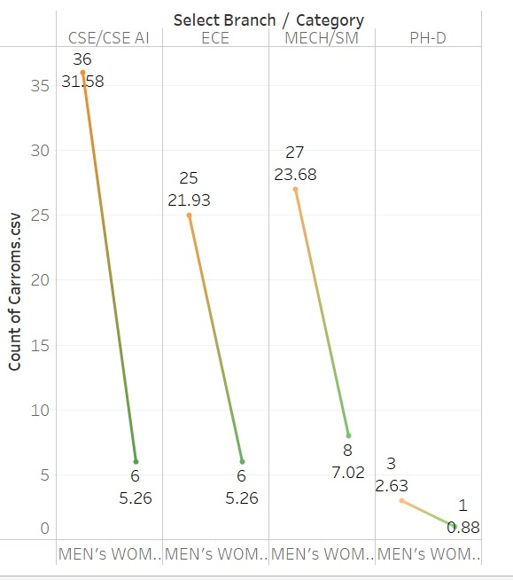
Data Analysis
This graph shows the number of students participating in the Inter Department Carrom Tournament.
Here, we see that CSE shows highest participation in male category with 36 students. Mechanical, ECE and PhD coming at 2nd, 3rd and 4th with 27, 25 and 3 students respectively.
In female category, CSE and ECE show the same amount of participation; 6. Mechanical and PhD show the most and least participation with 8 and 1 respectively.

Slide 26
Data Analysis
In the previous slide, we had a look at 4 graphs. The top left corner graph shows the comparison of the participation between female students and male students.
The bottom left corner graph shows the sports which each branch prefers the most by sorting them sports wise and branch wise. CSE students show the most participation with them leading in every sports except for athletics. Mechanical and ECE show almost similar participation, while PhD show the least amount of participation.

Slide 27
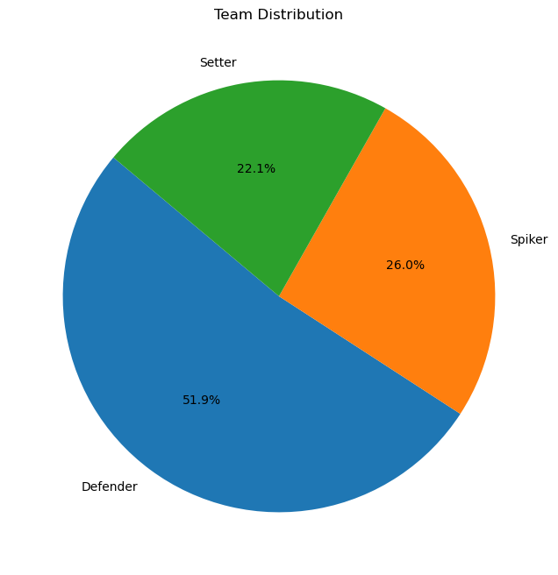
Data Analysis
This graph shows the responses of
the students who participated in
inter department volleyball tournament.
51.9% of the students, chose to play
‘Defender’ position, while 26% and
22.1% chose to play spiker and setter
respectively.

Slide 28
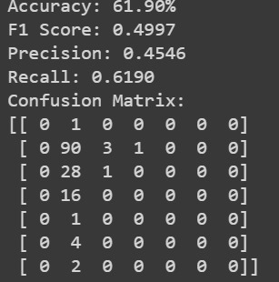
Data Analysis
Accuracy: Measures the overall correctness of predictions.
Precision: Indicates the ratio of true positive predictions to the total positive predictions made by the model for each class.
Recall (Sensitivity): Shows the ratio of true positive predictions to the total actual positive instances for each class.
F1-Score: Represents the balance between precision and recall and provides a harmonic mean of the two.
Support: Indicates the number of actual occurrences of each class in the test dataset, showing the class distribution.

Slide 29
Data Analysis
Accuracy is 0.61, which means that the model correctly predicted 61% of the test data. The precision for Badminton is 0.45, indicating that 45% of the predictions for Badminton were correct. For Badminton, the recall is 0.61, which means the model captured 61% of the actual Badminton instances. For badminton, the F1-Score is 0.49, indicating a balance between precision and recall for that class. The support for Badminton is 49, meaning there are 49 instances of the badminton class in the test dataset.

